Slide 1
PROCEEDINGS, INDONESIAN PETROLEUM ASSOCIATION
Thirty-sixth Annual Convention and Exhibition, 23 – 25 May, 2012
Basin Evolution and Hydrocarbon Geochemistry of the Lariang-Karama Basin: Implications for Petroleum System in Onshore West Sulawesi
By :
Safto Raharjo ¹
Lawrence D. Meckel ¹
Ferry Hakim ¹
Rob Seago ²
Edi Wahyu Jatmiko ³
Tately Budong-Budong N.V
Consultant Structural Geology
Corelab Indonesia

Slide 2
CONTENTS
  OBJECTIVES AND METHODOLOGY
  LOCATION OF STUDY
  REGIONAL TECTONICS
  STRATIGRAPHY
  BASIN EVOLUTION / TECTONO-STRATIGRAPHY
  PETROLEUM SYSTEM
  SUMMARY

Slide 3
OBJECTIVE AND METHODOLOGY
OBJECTIVES and METHODOLOGY
  Evaluate Tertiary Basin Evolution and Tectono-Stratigraphic model
    Integrate stratigraphy
      field and well data and previous work
    Construct structural model
      field data, onshore and offshore seismic profiles
  Analyse and interpret hydrocarbon geochemistry
  Predict the impact of above points on the Petroleum System

Slide 4
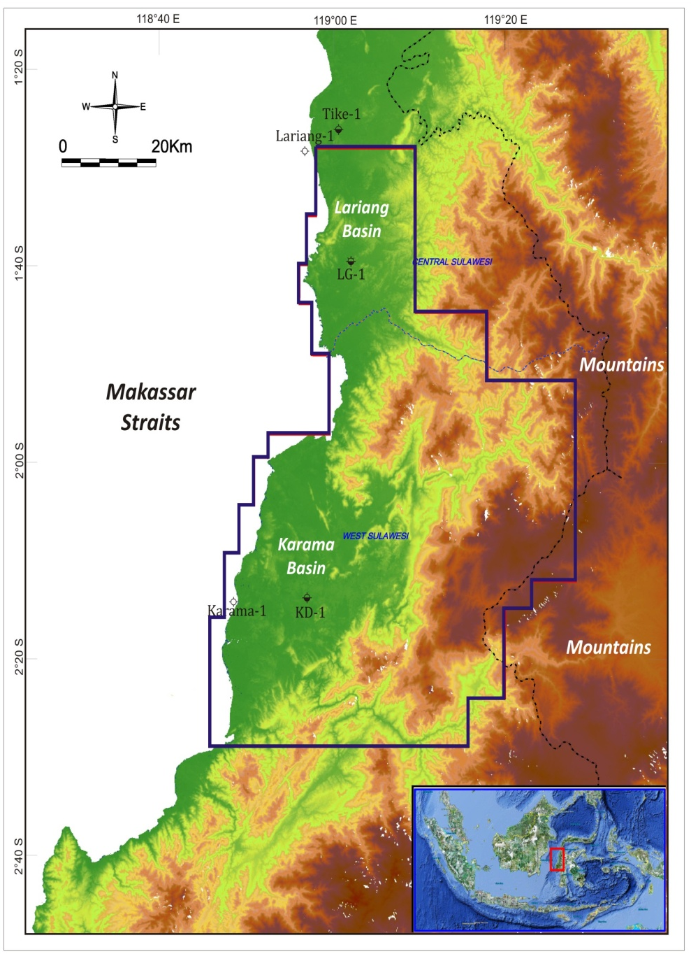
LOCATION OF STUDY
Notes:
Well symbol

Slide 5
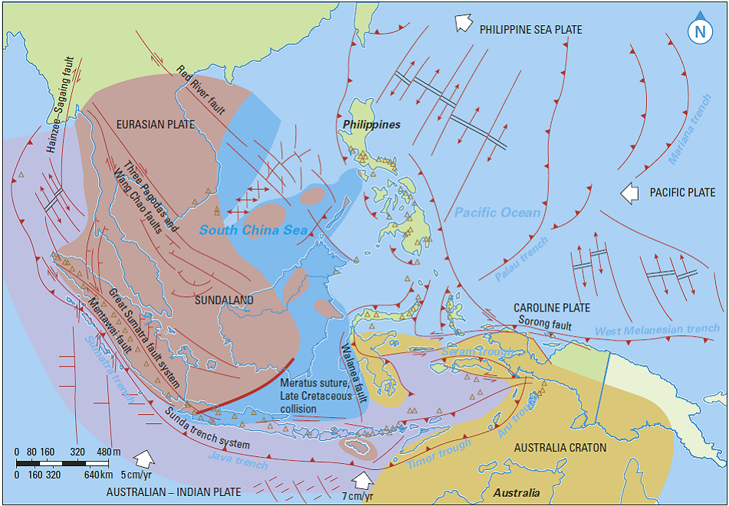
REGIONAL SETTING
(Fraser, 2003)
Notes:
Replaced with fraser tectonic

Slide 6
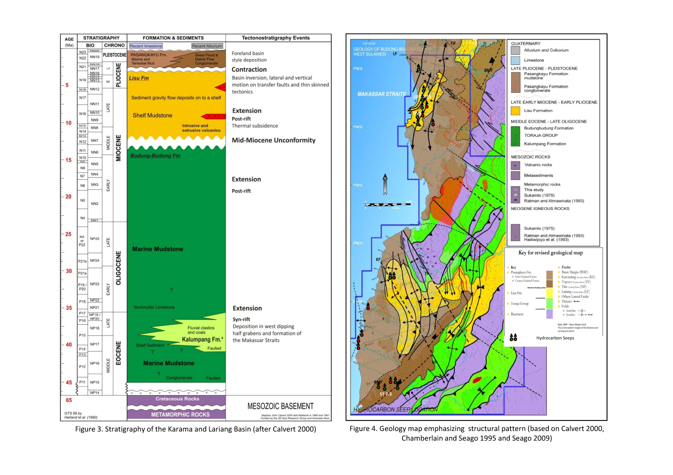
STRATIGRAPHY
STRATIGRAPHY OF LARIANG-KARAMA AREA
GEOLOGY MAP of the CONCESSION
Tike-1
Lariang-1
LG-1
Toraja Group
Karama-1
KD-1
( After Calvert, 2000 )
( Based on Calvert 2000, Chamberlain and Seago 1995 and Seago 2009 )

Slide 7
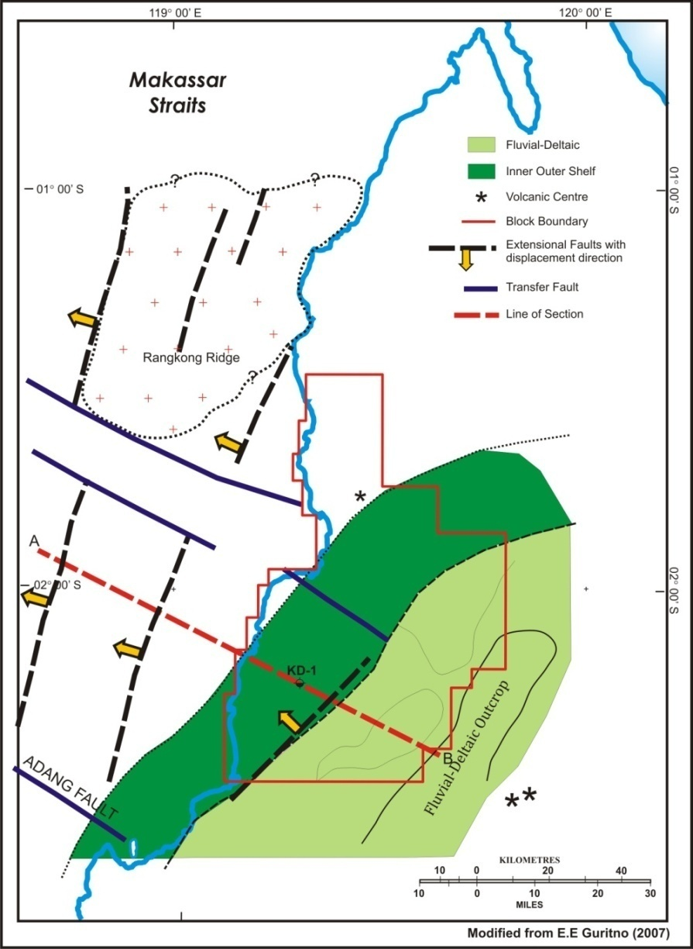
BASIN EVOLUTION / TECTONOSTRATIGRAPHY
NW
SE
A
B
Toraja Group
Basement
Syn-rift deposition in NW dipping half-grabens.
Fluvio-deltaic deposition in the SE (Kalumpang Fm.) and marine deposition in the west (Budung-Budung Fm.)
Syn-rift Palaeogeography of Middle Eocene (Kalumpang and Budung-Budung Fm)

Slide 8
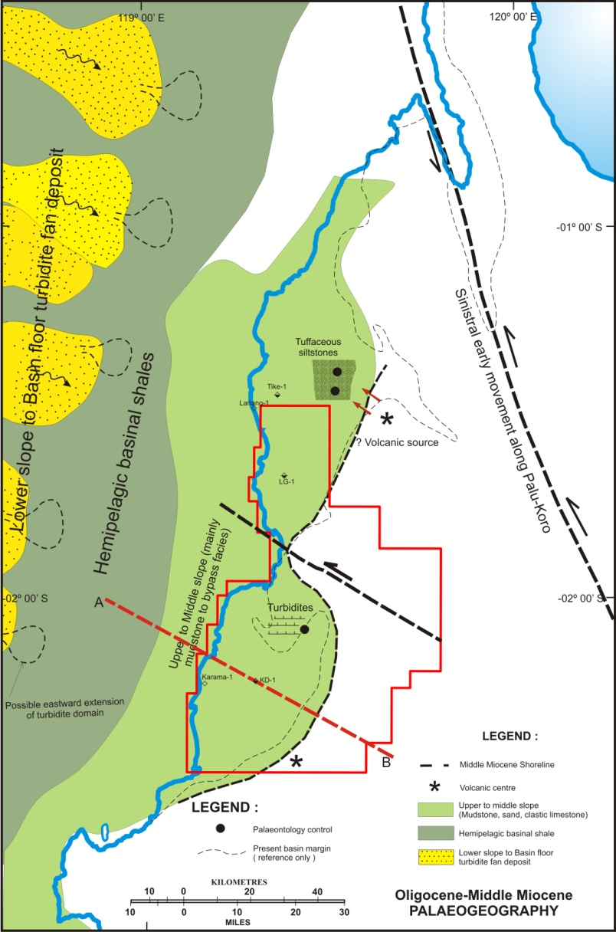
BASIN EVOLUTION / TECTONOSTRATIGRAPHY
NW
SE
A
B
Oligocene-Mid Miocene Toraja Group
Eocene Toraja Group
Basement
Rifting ceased in the Late Eocene/Oligocene
Extension period of thermal subsidence
Deepening Paleobathymetric conditions from south to north
(Based on Norvick and Pile, 1976., Fraser, 2003., Pieters, 2011)
Post-rift Palaeogeography of Oligocene-Mid Miocene (Budung-Budung Fm)

Slide 9
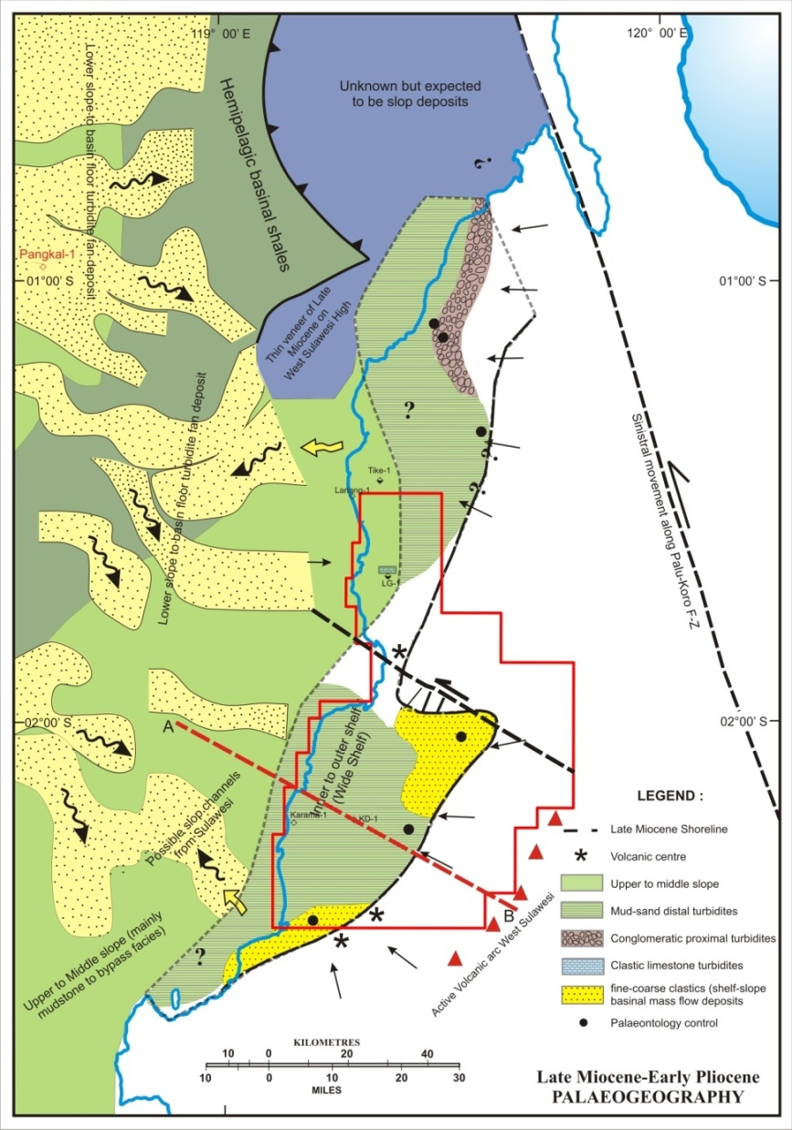
BASIN EVOLUTION / TECTONOSTRATIGRAPHY
NW
SE
A
B
Late Mio-Early Plio (Lisu Fm)
Eocene-Mid Miocene Toraja Group
Basement
Extension and related volcanic activity during thermal subsidence
Post-rift marine shelf deposition across basin (Lisu Fm)
Palaeoflow from NW in offshore area
Variable palaeoflow in nearshore area. Sediments derived from localised highs produced during footwall uplift and relative motion on transfer faults
(Based on Norvick and Pile, 1976., Fraser, 2003., Pieters, 2011)
Post-rift Palaeogeography of Late Miocene-Early Pliocene (Lisu Fm)

Slide 10
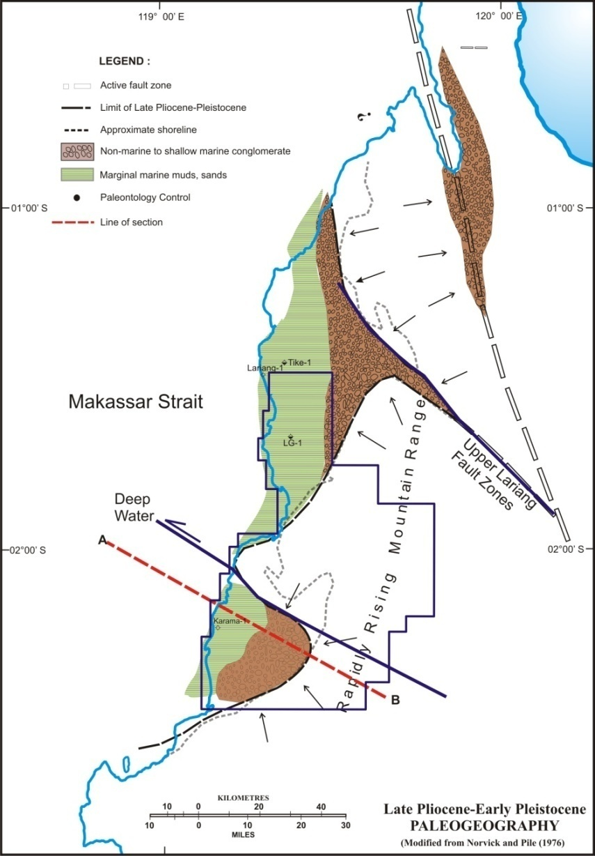
BASIN EVOLUTION / TECTONOSTRATIGRAPHY
NW
SE
A
B
Pasangkayu Fm
Lisu Fm
Toraja Group
Basement
Basins invert in the west prior to thrust front passing through from SE-NW
Large amounts of relative uplift on NW-SE, sinistral, transfer faults
NW progradation of clastic sequence – fines to west
Variable palaeoflow off localised highs resulting from movement on transfer faults and uplift in the SE
(Modified from Norvick and Pile,1976)
Basin Inversion and Contraction (Late Pliocene-Pleistocene)

Slide 11
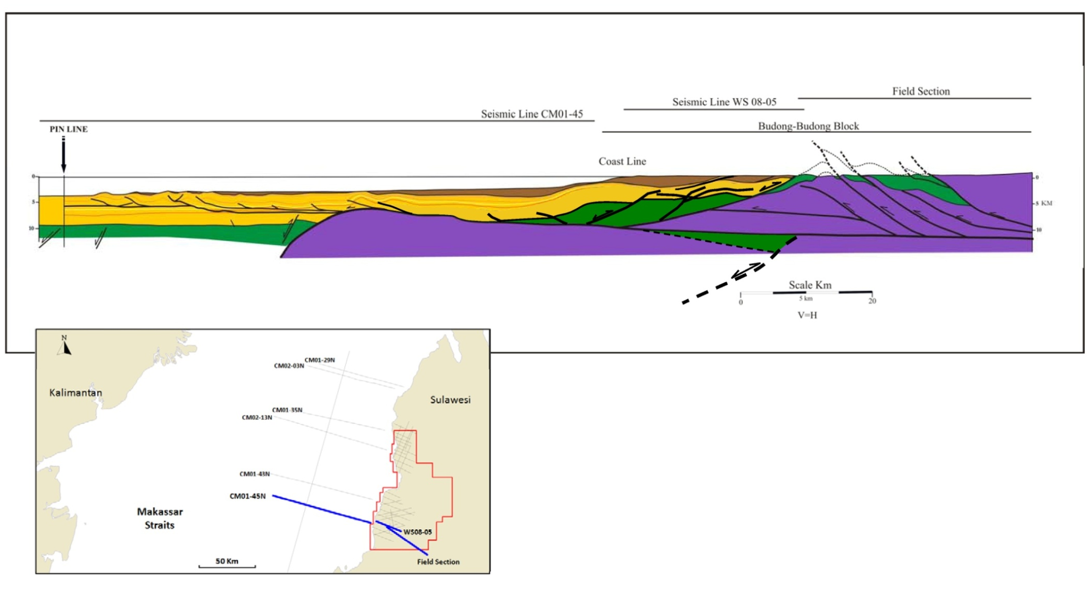
BASIN EVOLUTION / TECTONOSTRATIGRAPHY
Basal Detachment
Basement
Normal Fault
Toraja Group
Thrust Fault
Inverted normal Fault
Lisu Formation
Basin Margin Fault
Pasangkayu Formation
Composite balanced cross section across West Sulawesi using field, onshore and offshore seismic data

Slide 12
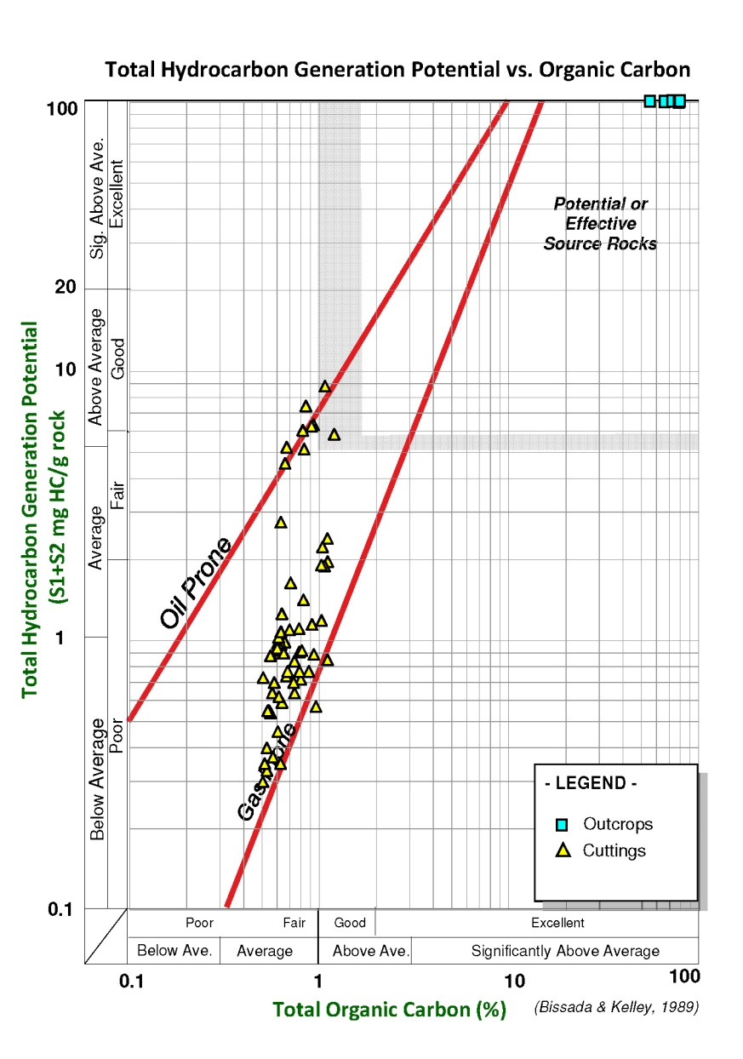
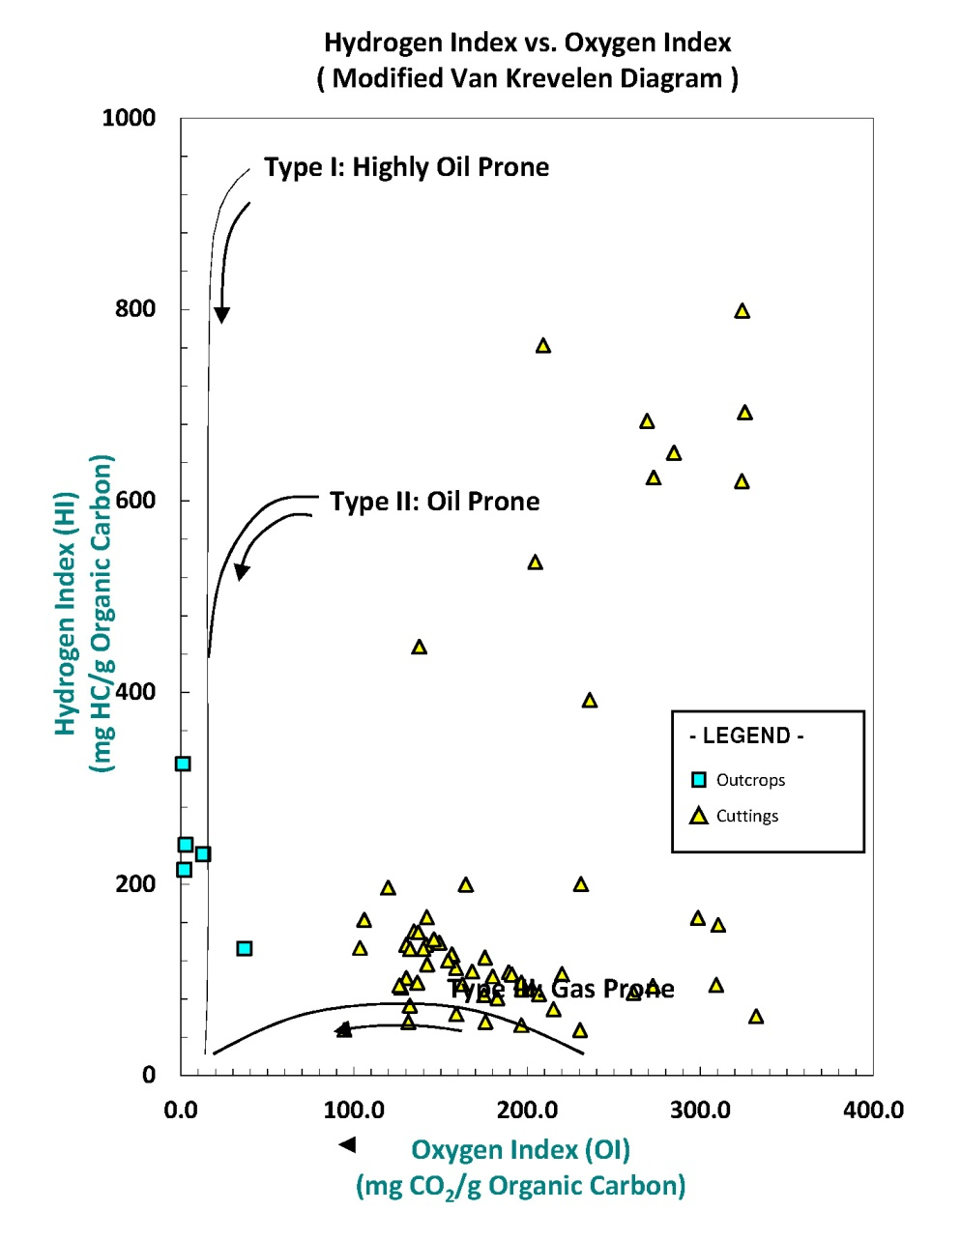
PETROLEUM SYSTEM – Source Rock
Potential source rock from coal (outcrop) and (cuttings)

Slide 13
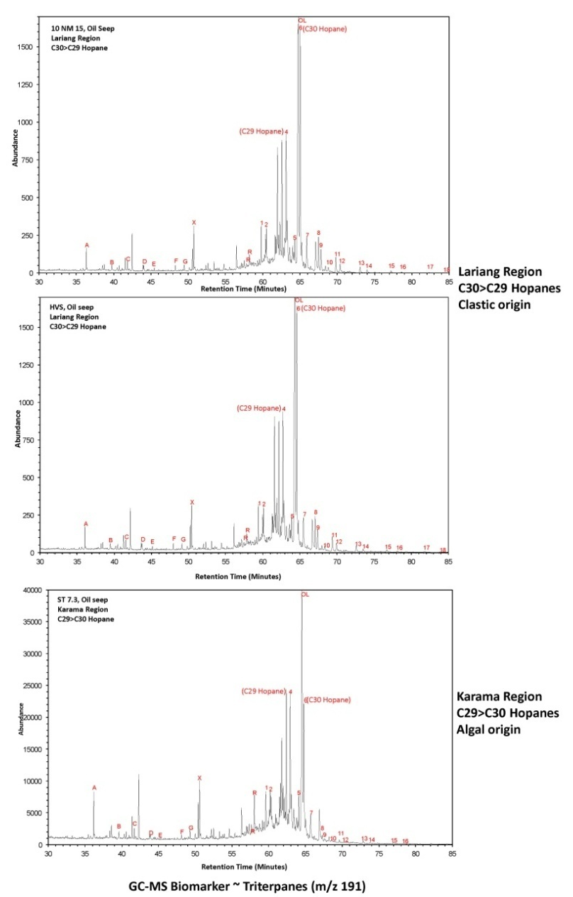
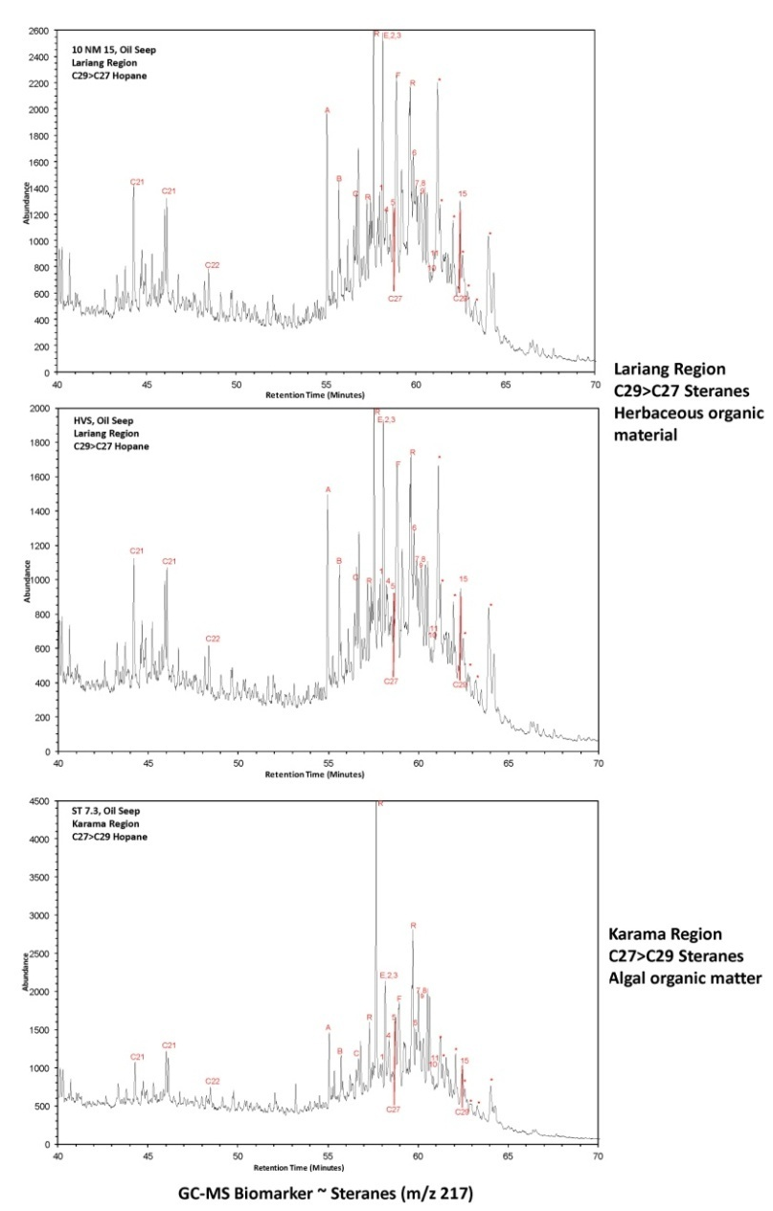
PETROLEUM SYSTEM – Source Rock
Sample-1
Sample-1
Sample-2
Sample-2
Sample-3
Sample-3
GC-MS Biomarker Triterpane (m/z 191) and Sterane (m/z217) of Oil Seeps

Slide 14
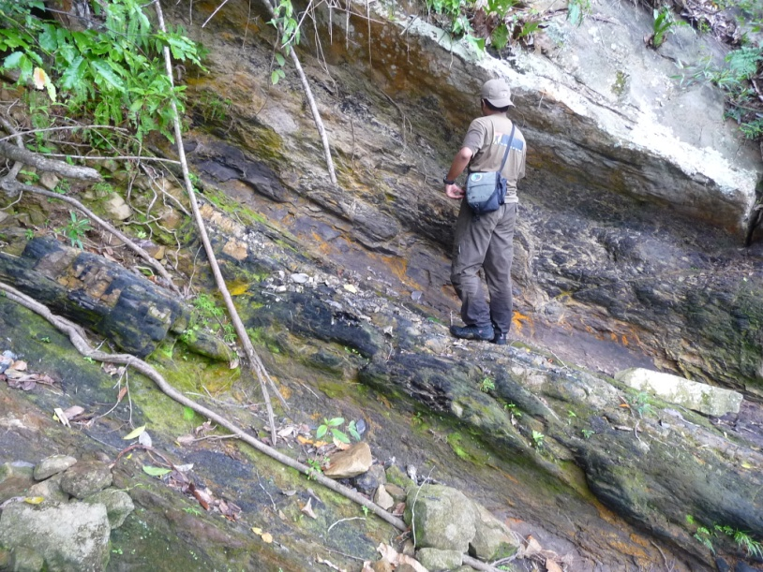
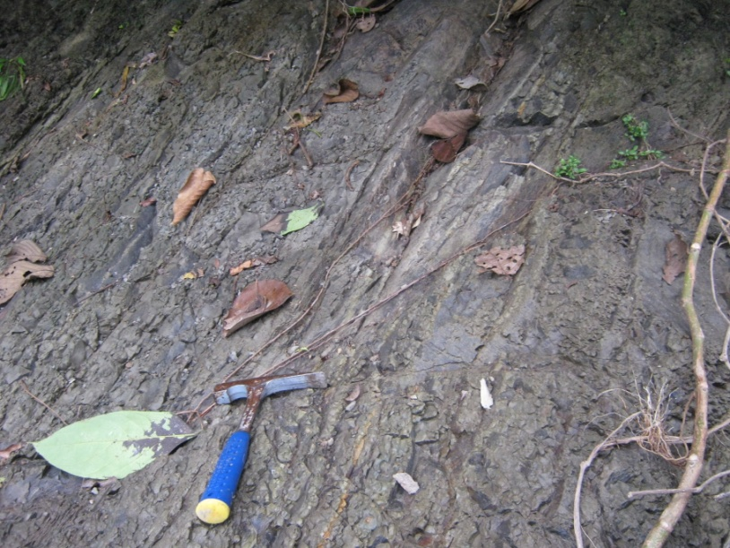
PETROLEUM SYSTEM – Source Rock & Charge
SOURCE ROCK
Syn-rift of Eocene (Fluvial – Deltaic) Kalumpang Formation
And post-rift Miocene (Marine) Budung-Budung Formation
Coal
Photograph by Peter-Pieter 2010
Photograph by Peter-Pieter 2010
Coal Outcrop of Kalumpang Fm
Marine mudstone of Budung-Budung Fm
TIMING AND MIGRATION
Hydrocarbons generated from the Tertiary section and migration into traps is believed to be facilitated by interconnected fluvial and shallow marine sands

Slide 15
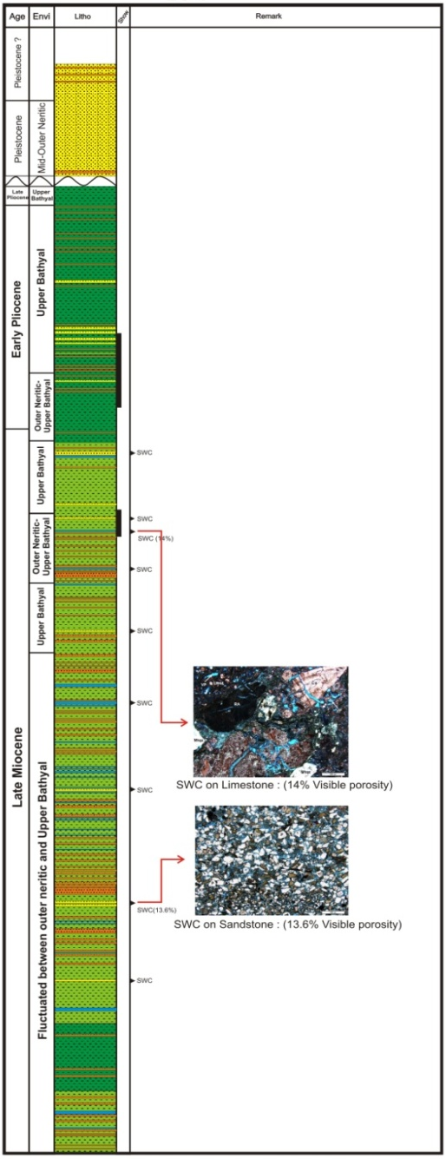
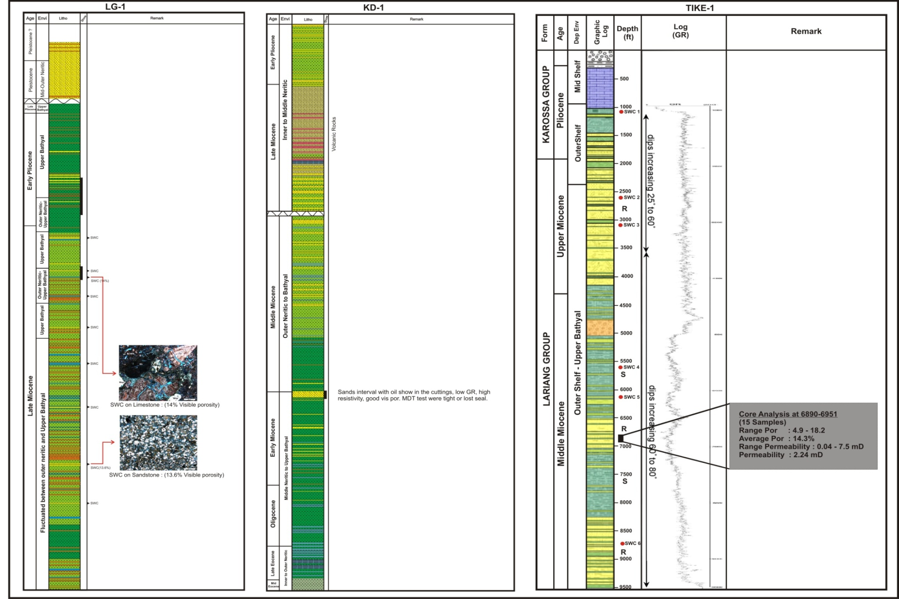
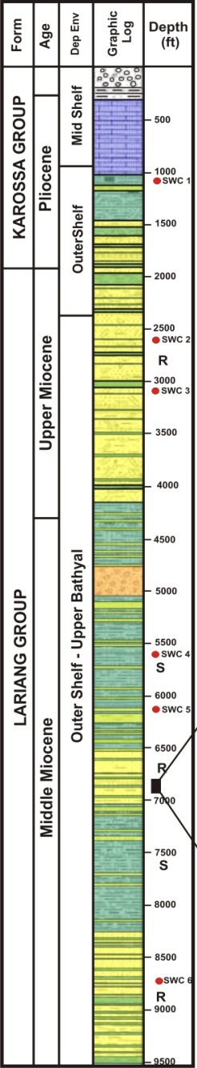
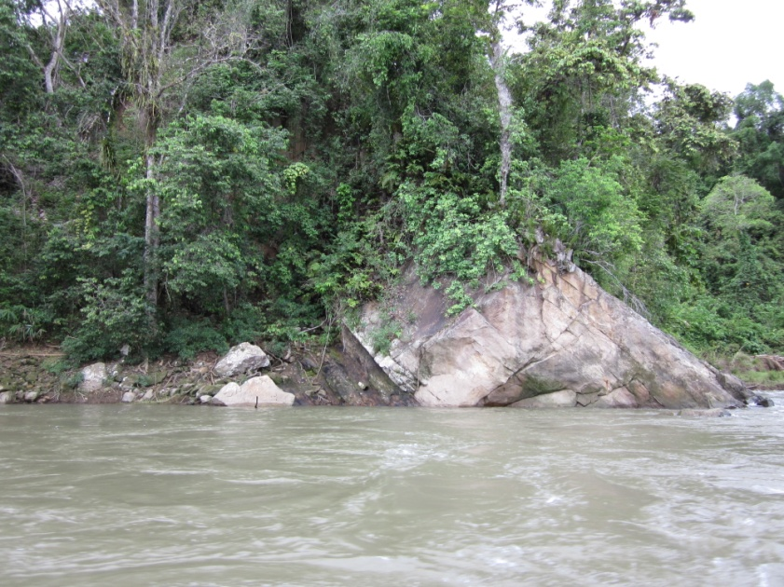
PETROLEUM SYSTEM - Reservoir
LG-1
KD-1
Tike-1
Outcrop Data
Mudstone Carbonaceous
Quartz Sandstone
Kalumpang Formation outcrop (10SS195S1)
Photograph by Peter-Pieter 2010
Porosity of Eocene Outcrop
20 sandstones outcrop :
Individual Thickness : 1 – 20m
Range Porosity : 7.5% - 26 %
Average Porosity : 17%
Volcaniclastic sandstones :
Monocrystalline quartz (average 33%)
Lithic fragments (average 28%)
Minor component include feldspar, mica, polycrystaline quartz and heavy minerals
Reservoir quality is influenced predominantly by compaction or by calcite cementation
Qm
SWC Analysis at 6890-6951
(15 Samples)
CRATON
Range Por : 4.9 - 18.2
INTERIOR
Average Por : 14.3%
Range Permeability : 0.04 - 7.5 mD
QUARTZOSE
Permeability : 2.24 mD
TRANSITIONAL
RECYCLED
CONTINENTAL
MIXED
DISSECTED ARC
TRANSITIONAL
BASEMENT
RECYCLED
UPLIFT
TRANSITIONAL ARC
LITHIC
UNDISSECTED ARC
RECYCLED
Miocene Reservoir Quality
F
(after Dickinson et al, 1983)
Lt
Eocene Reservoir Quality

Slide 16
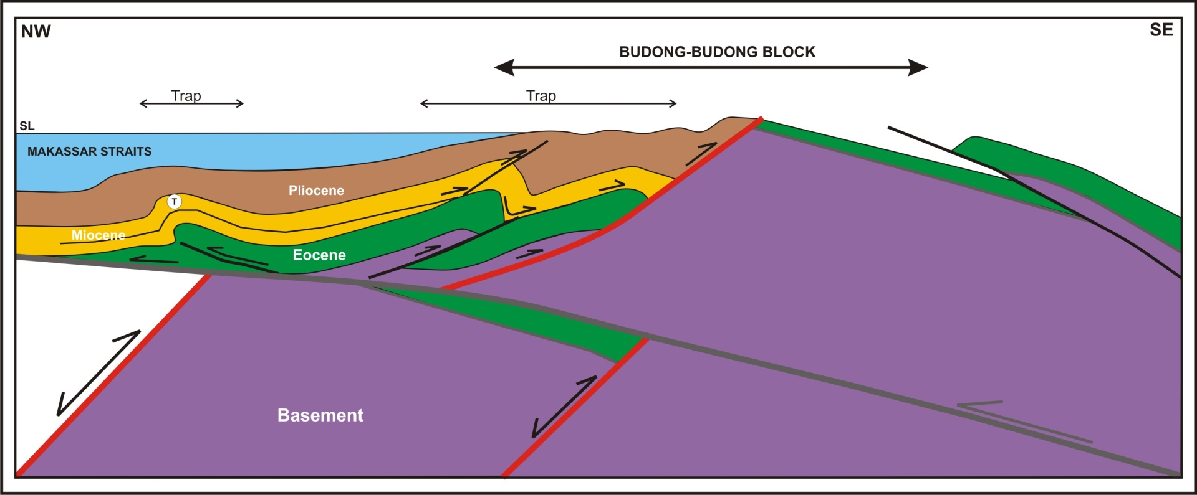
PETROLEUM SYSTEM – Trap & seal
TRAP
Thrust bounded fold closures within the Tertiary sequence
SEAL
Syn-rift intra-formational shales within Eocene section and post-rift regional shales of the Late Eocene – Mio Pliocene

Slide 17
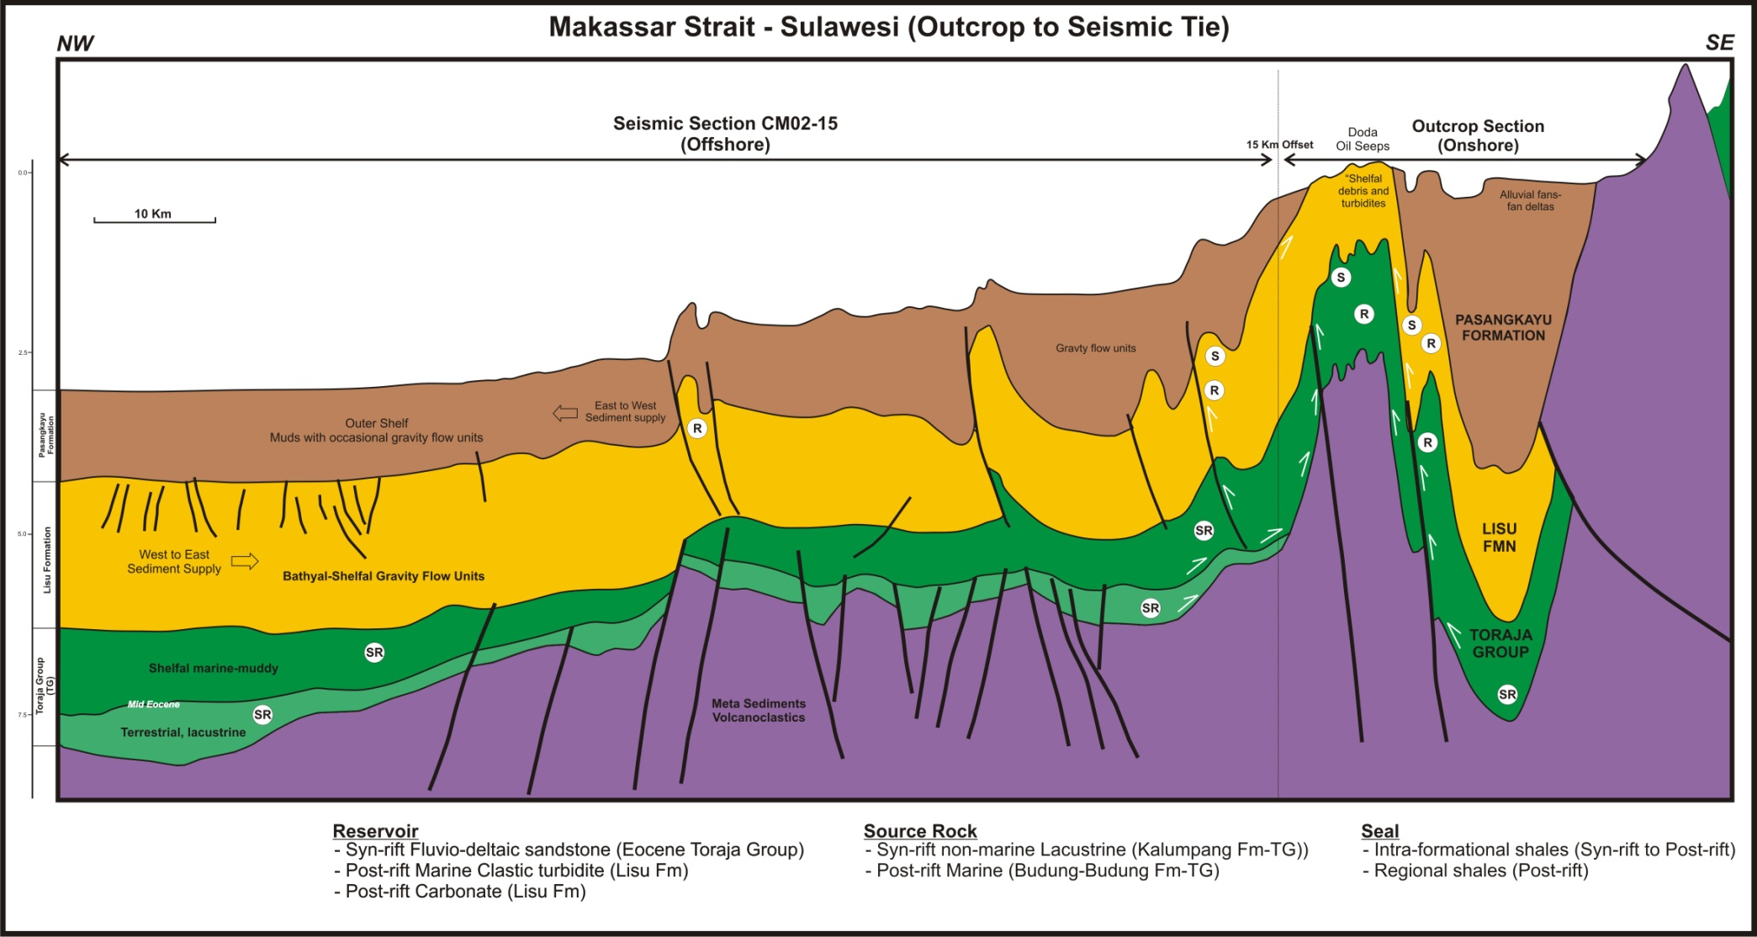
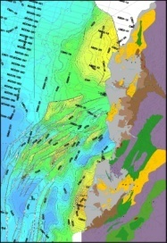
PETROLEUM SYSTEM
Budong-Budong Setting
CM02-15
C
C’
Play Type

Slide 18
SUMMARY
Extension initiated in the Middle Eocene continued into the Early Pliocene (Syn-rift and Post-rift).
Contraction and basin inversion in Late Pliocene/Pleistocene in response to thrust front advance and movement on transfer faults.
The Lariang and Karama areas demonstrate an active working petroleum system
Oil is present and the contractional event of the Late Plio-Pleistocene has produced numerous anticlinal traps
Traps were filled following generation and migration of HC (Tertiary to the present).

Slide 19
SUMMARY
Miocene clastic reservoirs are present but are of questionable quality. Further evaluation of sand fairways during the Miocene period will be critical for any further exploration program
Eocene fluvio-deltaic sands indicate good reservoir quality from the outcrop data but it is still questionable whether the Eocene terrestrial facies occur west of the present day mountain front.
Regional seals are present.

Slide 20
THANK YOU
Acknowledgments :
Tately Budong-Budong N.V
Harvest Natural Resources
BPMIGAS
Peter Pieters (Rekaindo Internusa)
John Harrington (Corelab Indonesia)

